Slide 1
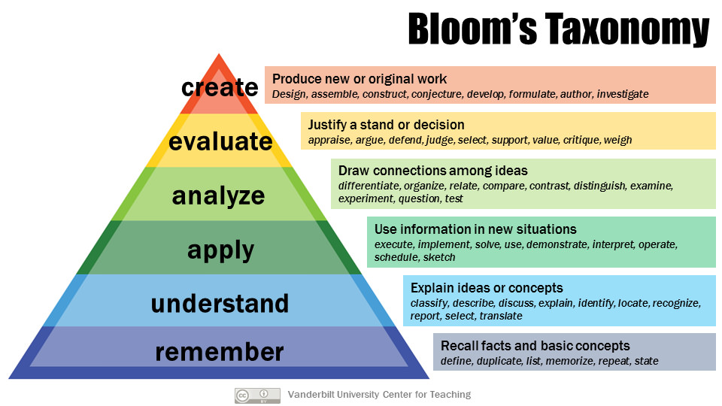
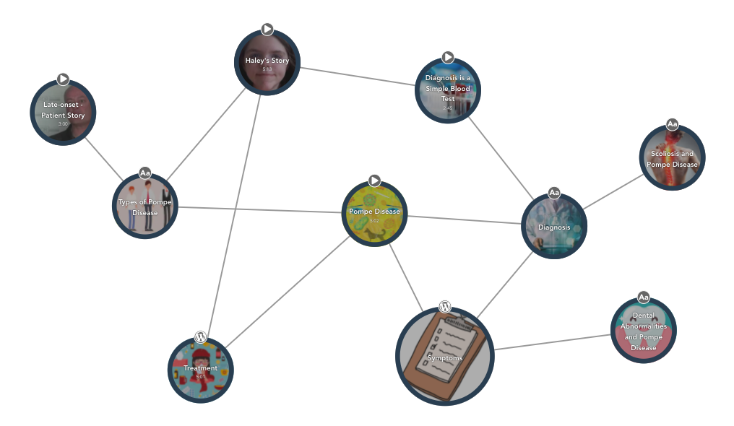
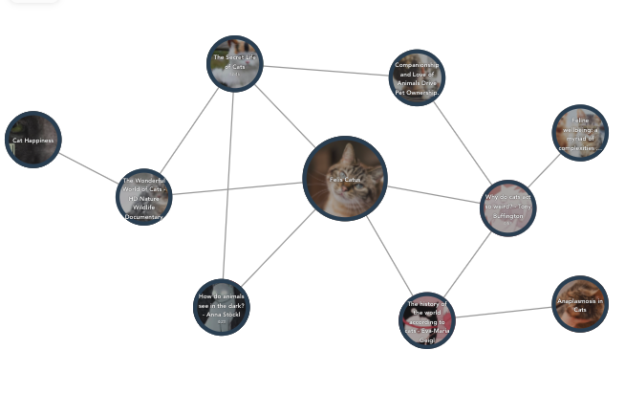
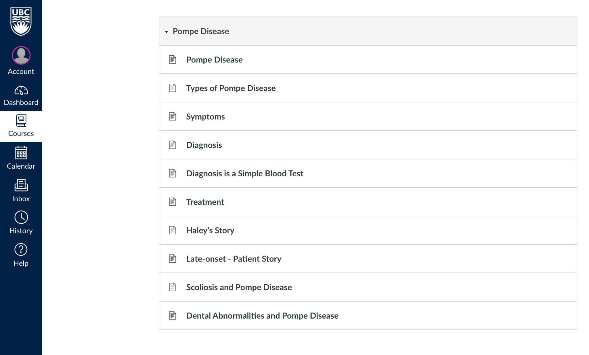
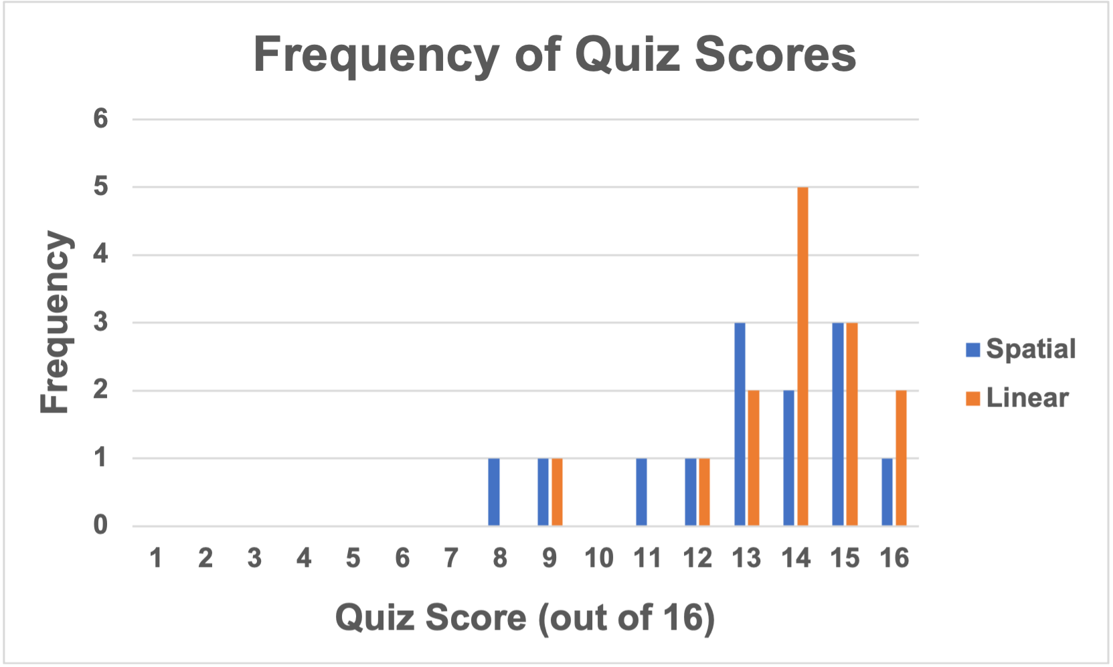
Online Learning Platforms:
Comparing Learning Between Tapestry and Canvas Use
By: Bita Jokar, Heather McFadyen, Melanie Butt, Steven J. Barnes
INTRODUCTION
METHOD
PROJECTED RESULTS
The Tapestry Tool is TLEF-funded and UBC-developed
Encouraging non-linearity and collaboration
Increased student engagement in online learning environments associated with improved learning outcomes.¹
Administered using Qualtrics, Zoom, and HSP
Participants randomly assigned to Tapestry or Canvas
Screen-recorded while viewing content, screen-share during quiz
Brown-Peterson distractor task as short-term memory (STM) clear
Count backwards in threes from a given number for 30 seconds
Quiz questions from first four levels of Bloom’s taxonomy
Higher quiz score → greater probability of winning a $50 Amazon gift card
1 correct quiz answer =
1 entry into raffle
Higher mean test scores for Tapestry condition
And, scoring better on higher-level questions (Bloom’s Taxonomy)
Learning differences for neurodivergent participants
Armstrong, P. (2010). Bloom’s Taxonomy. Vanderbilt University Center for Teaching. Retrieved 06 April 2021 from https://cft.vanderbilt.edu/guides-sub-pages/blooms-taxonomy/.
LIMITATIONS
RESEARCH QUESTION
Zoom setting (e.g., uncontrollable environmental stimuli)
Unsure if used aids during quiz
Lab versus classroom learning
Does using Tapestry improve participants’ learning experience and retention of material as compared to using Canvas, and is there a greater improvement for non-neurotypical students?
Tapestry learning condition
FUTURE DIRECTIONS
PILOT STUDY
Time spent on 15-min quiz:
<7 mins: 4/27
<10 mins: 6/27
<15 mins: 14/27
In-class learning experiment
Learning in the long term
PROCEDURE
Walk-through video
2 minute trial content
25 minute test content
STM clear
Quiz
Experiential learning questions
Acknowledgments: Aidin Niavarani, Trish Varao-Sousa, Stephanie Chen, UBC Teaching and Learning Enhancement Fund
(1) Dodson, S., Roll, I., Fong, M., Yoon, D., Harandi, N.M., Fels, S. (2018). An active viewing framework for video-based learning. Proceedings of the Fifth Annual ACM Conference on Learning at Scale (L@S '18). ACM, New York, NY, USA, Article 24, 4 pages. https://doi.org/ 10.1145/3231644.3231682
Canvas learning condition

