Slide 1
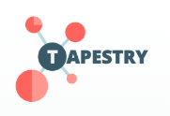
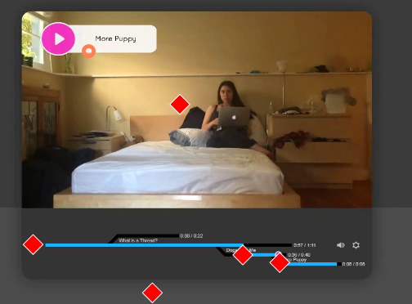
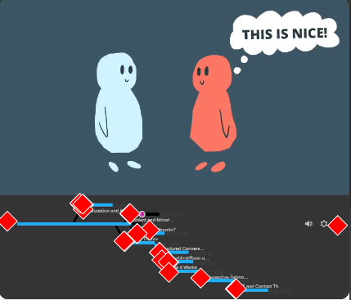
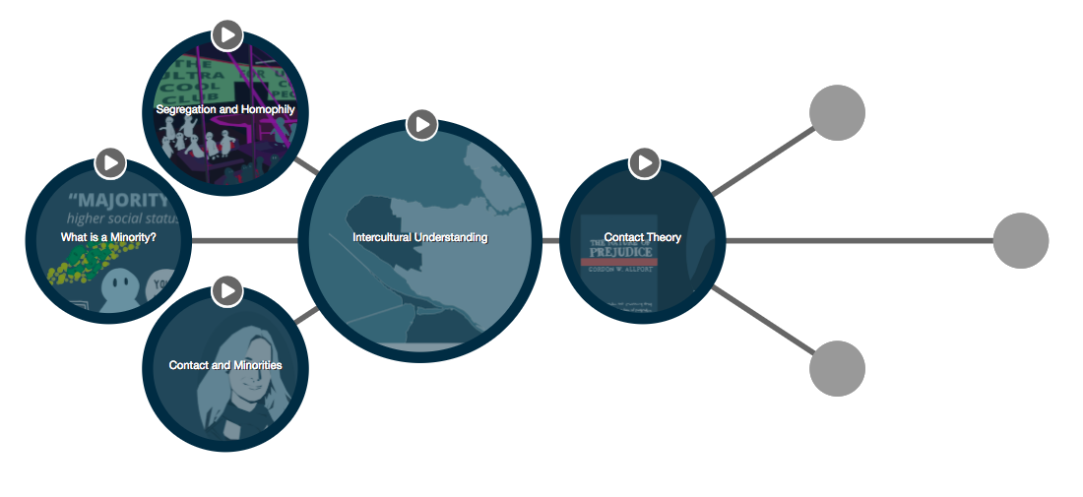
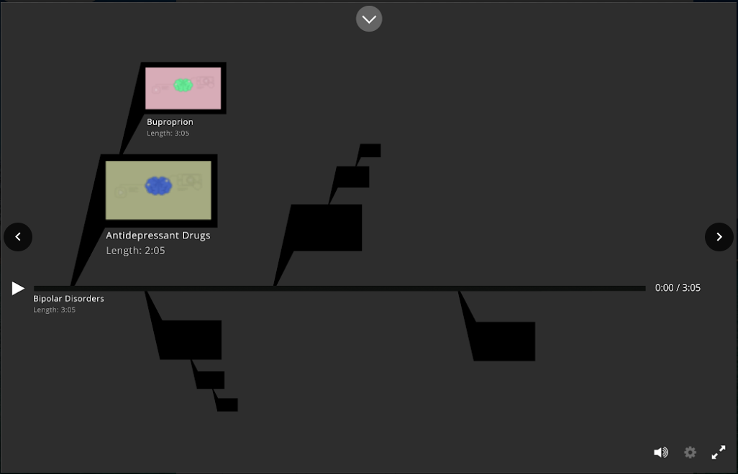
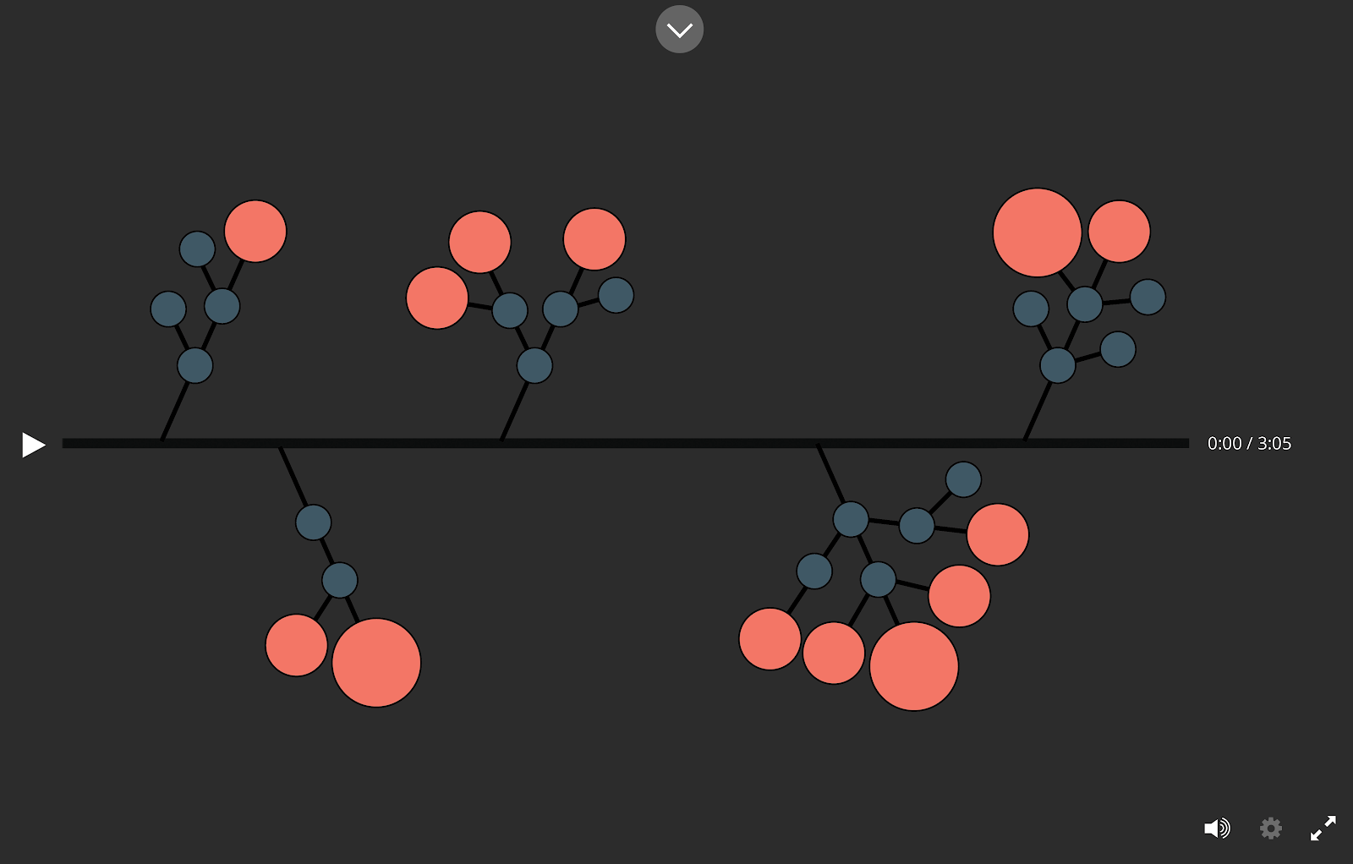
Evaluation of the new student learning tool: Tapestry
Bita Jokar, Trish Varao-Sousa, and Steven J. Barnes
The University of British Columbia, Vancouver, BC, Canada.
INTRODUCTION
RESULTS
CONCLUSION & FUTURE DIRECTIONS
Tapestry is a new UBC developed online learning tool that aims to amplify the learning experience for students and facilitate the teaching process for instructors.
Tapestry incorporates a mind map structure that allows an instructor to create and connect content in a unique and innovative fashion.
This tool is designed to provide students with a novel way to view learning material, incorporate new content and create links between existing content.
Tapestry 1.0
Survey results showed that participants preferred:
Branches leading to nodes that were thicker.
Important information about the node to be found within the node itself.
Color used for the progress bar.
Eye-tracking results:
Students had difficulty pressing on a new branch on the timeline.
Students were not using interaction button on the main video (see Figure 1).
Students wanted their progress to be saved.
Students spent 27% of the time in the instructional video looking at the timeline.
Students spent 18% of the time during the video looking at the timeline.
Tapestry 2.0
Key points of concern from student focus groups:
Design of the interface (i.e., wanting a zoomed out view)
In-class participation (i.e., use as a group project)
Interacting with classmates and instructors (i.e., chat feature)
Instructor focus groups:
Interacting with students (i.e., chat feature)
Assignments (i.e., having students create their own Tapestry)
Tapestry 1.0
Subsequent version fixed the issue with the branches and incorporated a progress bar.
The lack of interaction button use led the development team to create a new interface that would help visually illustrate the connections between ideas without a pop-up in the middle of the video.
Tapestry 2.0
As development progresses, the ongoing goal is to gain further feedback on the extent to which students and instructors find the interface usable and interactive.
MATERIALS
Two versions of the Tapestry interface have been tested:
Tapestry 1.0: Linear design only using H5P
Tapestry 2.0: A node-based interface that includes D3
Tapestry is being developed using the H5P, D3, and WordPress platforms.
METHODS
Student and instructor focus groups
Interface presentation
Use-case-scenarios
Usability feedback
Qualtrics surveys
Testing the likeability and usability of interface
UES (O’Brien et al., 2018) and USE scales
Eye-tracking studies (SMI eye-tracking system)
Studies that compared whether the participants were more focused on the video screen or the timeline.
Sample images given during the survey process.
Figure 3. A sample of the video player used in studying Tapestry 2.0.
Figure 1. The red diamonds indicate where the participant has clicked. The orange circle indicates the region of the screen the participants are looking in that moment.
Figure 2. Screenshot from an eye-tracking study. The red diamonds indicate where the participant has clicked.
Figure 4. An image of the intercultural understanding module in the Tapestry 2.0.
REFERENCES
O’Brien, H. L., Cairns, P., & Hall, M. (2018). A practical approach to measuring user engagement with the refined user engagement scale (UES) and new UES short form. International Journal of Human-Computer Studies, 112, 28-39. doi:10.1016/j.ijhcs.2018.01.004
USE Questionnaire: Usefulness, Satisfaction, and Ease of use. (n.d.). Retrieved on March 25, 2019, from https://garyperlman.com/quest/quest.cgi?form=USE
Notes:
TEMPLATE IS FULLY CUSTOMIZABLE. BOXES AND PLACEHOLDERS CAN BE REMOVED. COLOURS CAN BE CHANGED.
UBC LOGO MUST REMAIN TOP LEFT. UBC BRANDING BAR AT THE BOTTOM CAN BE DELETED IF DESIRED.

