Slide 1
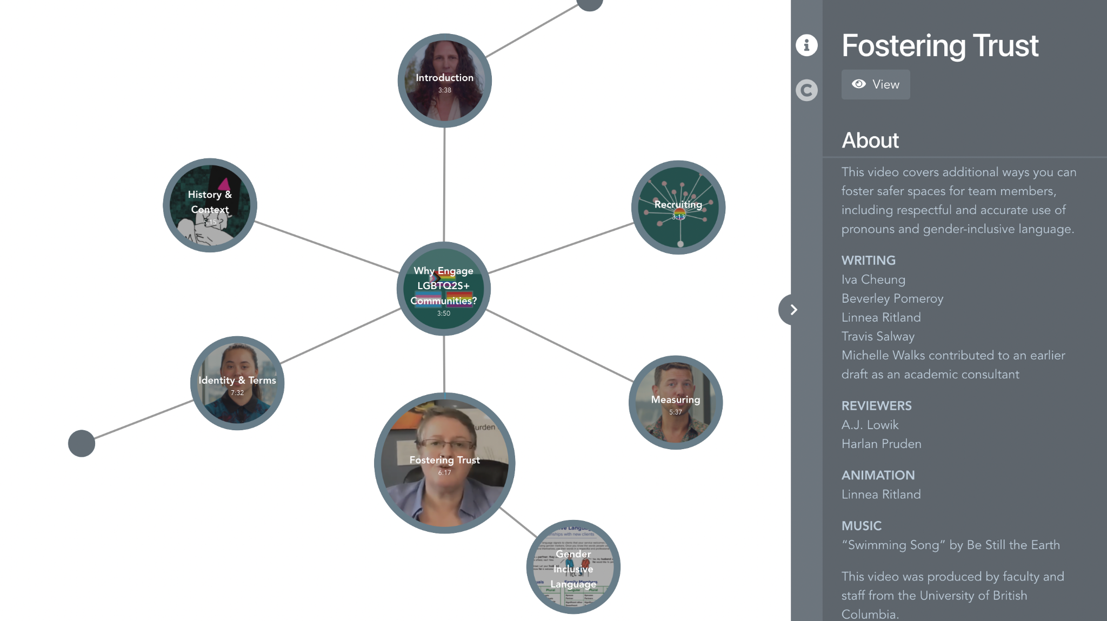
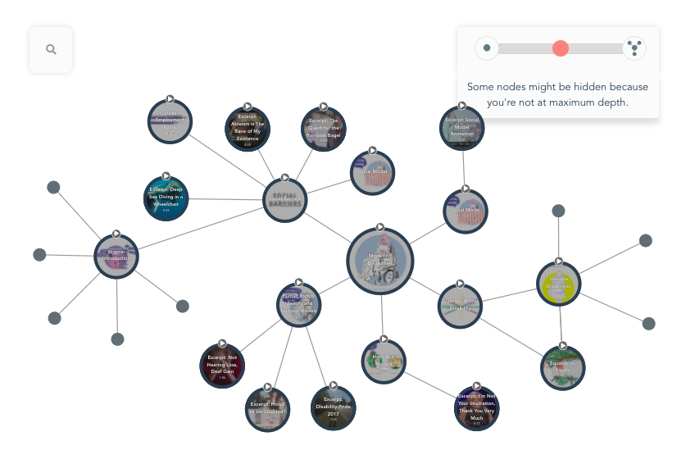
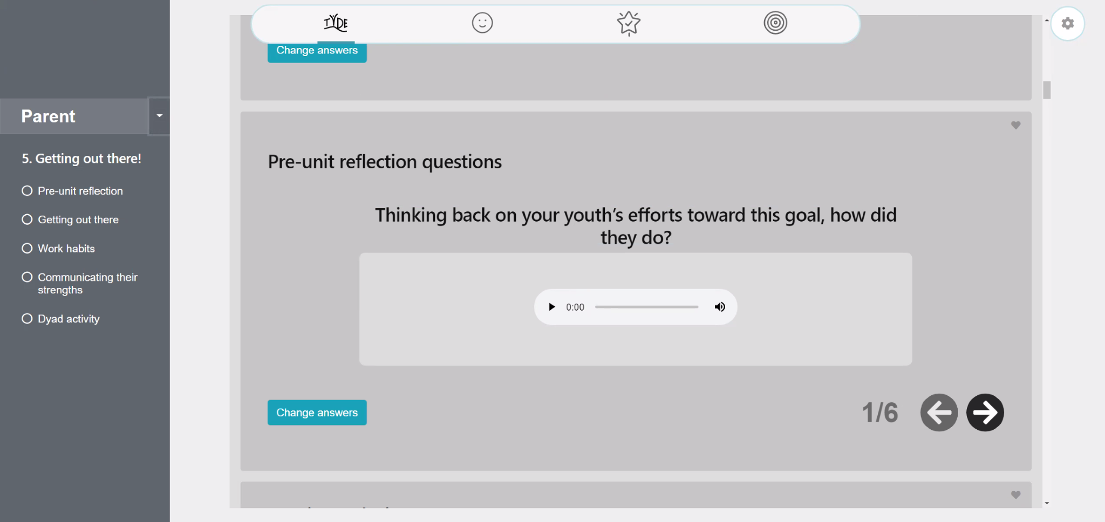
The Tapestry Tool: A Collaborative, Interactive, and Non-Linear Online Learning Tool
BC SUPPORT Unit
Melanie Butt, Bita Jokar, Steven J. Barnes
Introduction
Results
Video on JEDI in Long-Term Care
Patient Testimonials
What is The Tapestry Tool?
The Tapestry Tool is a collaborative educational tool that encourages the integration of multimedia content within a non-linear format; we call these collections of content “tapestries.”
The Tool is designed by students, faculty, and staff at UBC, and has been used in postsecondary settings, research settings, and by non-profit organizations.
Large Tapestries Study
Community-Engaged Research
A future iteration of the Tapestry Tool with dynamic zooming features
TYDE
BC SUPPORT Unit
Displays interactive and non-linear educational modules supporting diverse people and communities (e.g., LGBTQ2S+, Rural and Remote, and Deaf communities)
For more information, see: https://methodsclusters.ca/; https://www.bcahsn.ca/our-units/bc-support-unit
Group Member’s Notes
Methods
Iterative Design Process
Input from over a thousand UBC students, staff, and faculty.
Data collection through eye-tracking, focus groups and interviews, usability testing and surveys.
Transitioning Youth With Disabilities and Employment
The Tapestry Tool has been extensively adapted for use by the TYDE Project, allowing for a completely customized and highly interactive interface.
For more information, see: https://mytyde.ca.
“Disabilities” module tapestry used in the Large Tapestries Study
Learn More
Website: https://tapestry-tool.com/
Twitter: https://twitter.com/TapestryTool
Large Tapestries Study
BACKGROUND
Users had trouble navigating “large tapestries” (i.e., > 20 nodes)
Zoomed in: Lose connections/overview
Zoomed out: Lose node details
PROCEDURE
Users navigated a large tapestry
Viewed mockups and videos of proposed features; gave ratings and preferences
User experience questionnaires
Acknowledgements
Conclusion
Trish Varao-Sousa, Linnea Ritland, Aidin Niavarani, Erin Michalak, Rachelle Hole, Leilani Forby
The Tapestry Tool can be adapted to suit its context.
Facilitates knowledge exchange and helps advance community-engaged research and researcher collaboration.
We gratefully acknowledge the financial support for this project provided by UBC Vancouver students via the Teaching and Learning Enhancement Fund.

