Slide 1
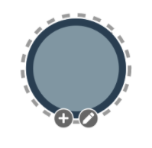
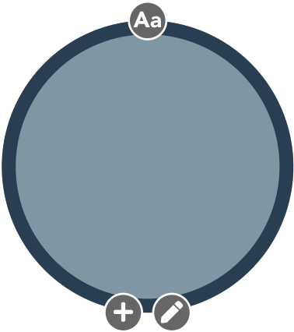
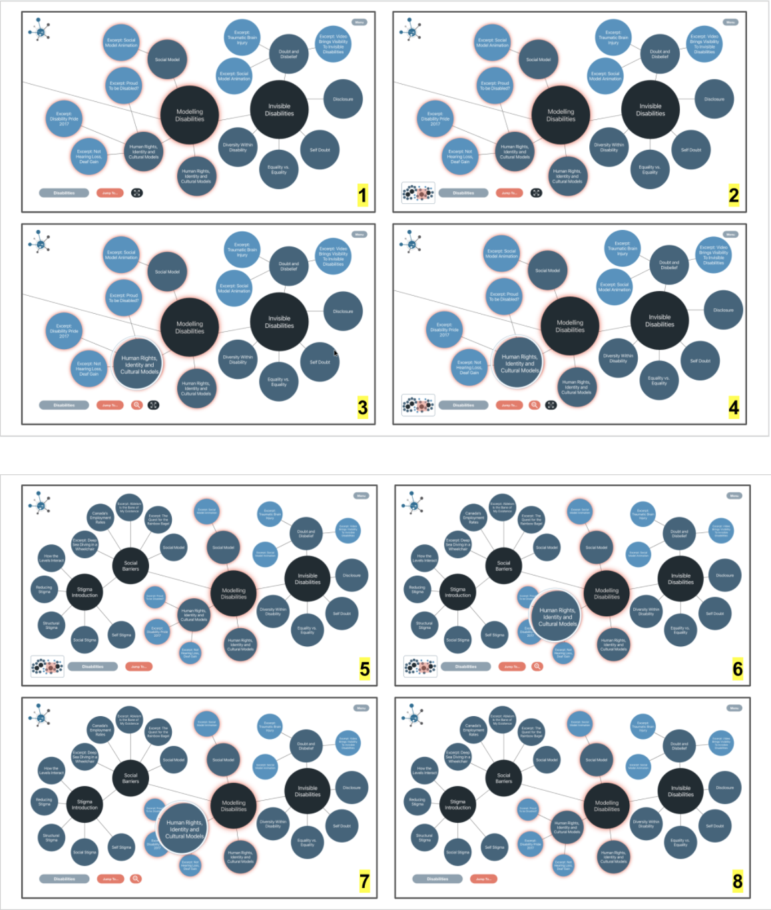
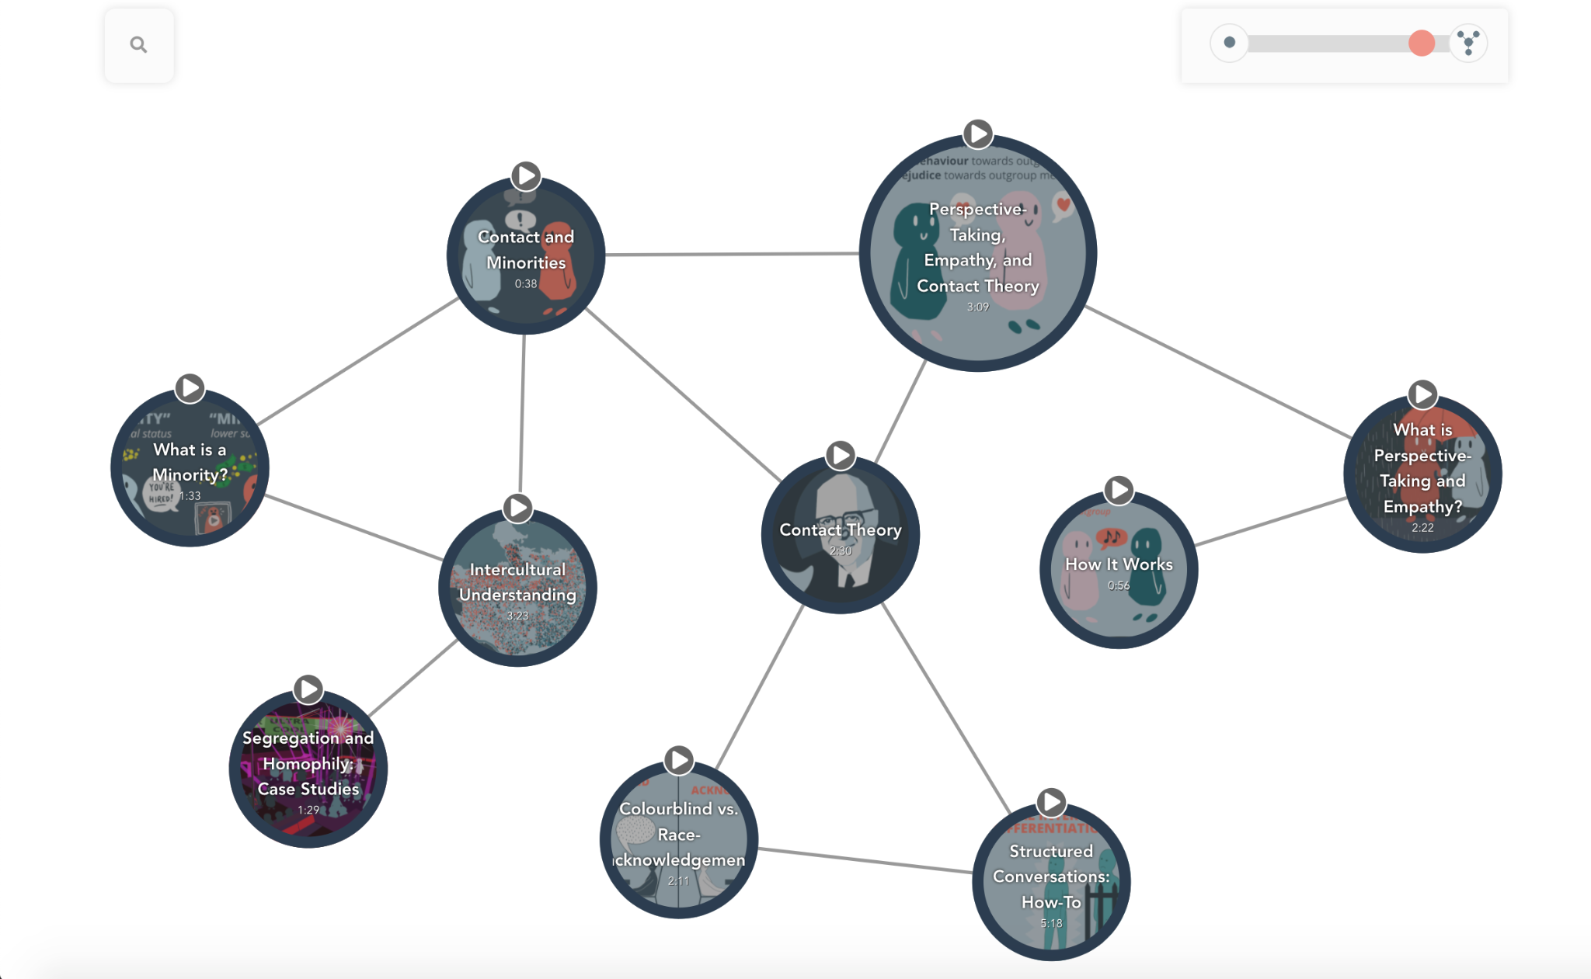
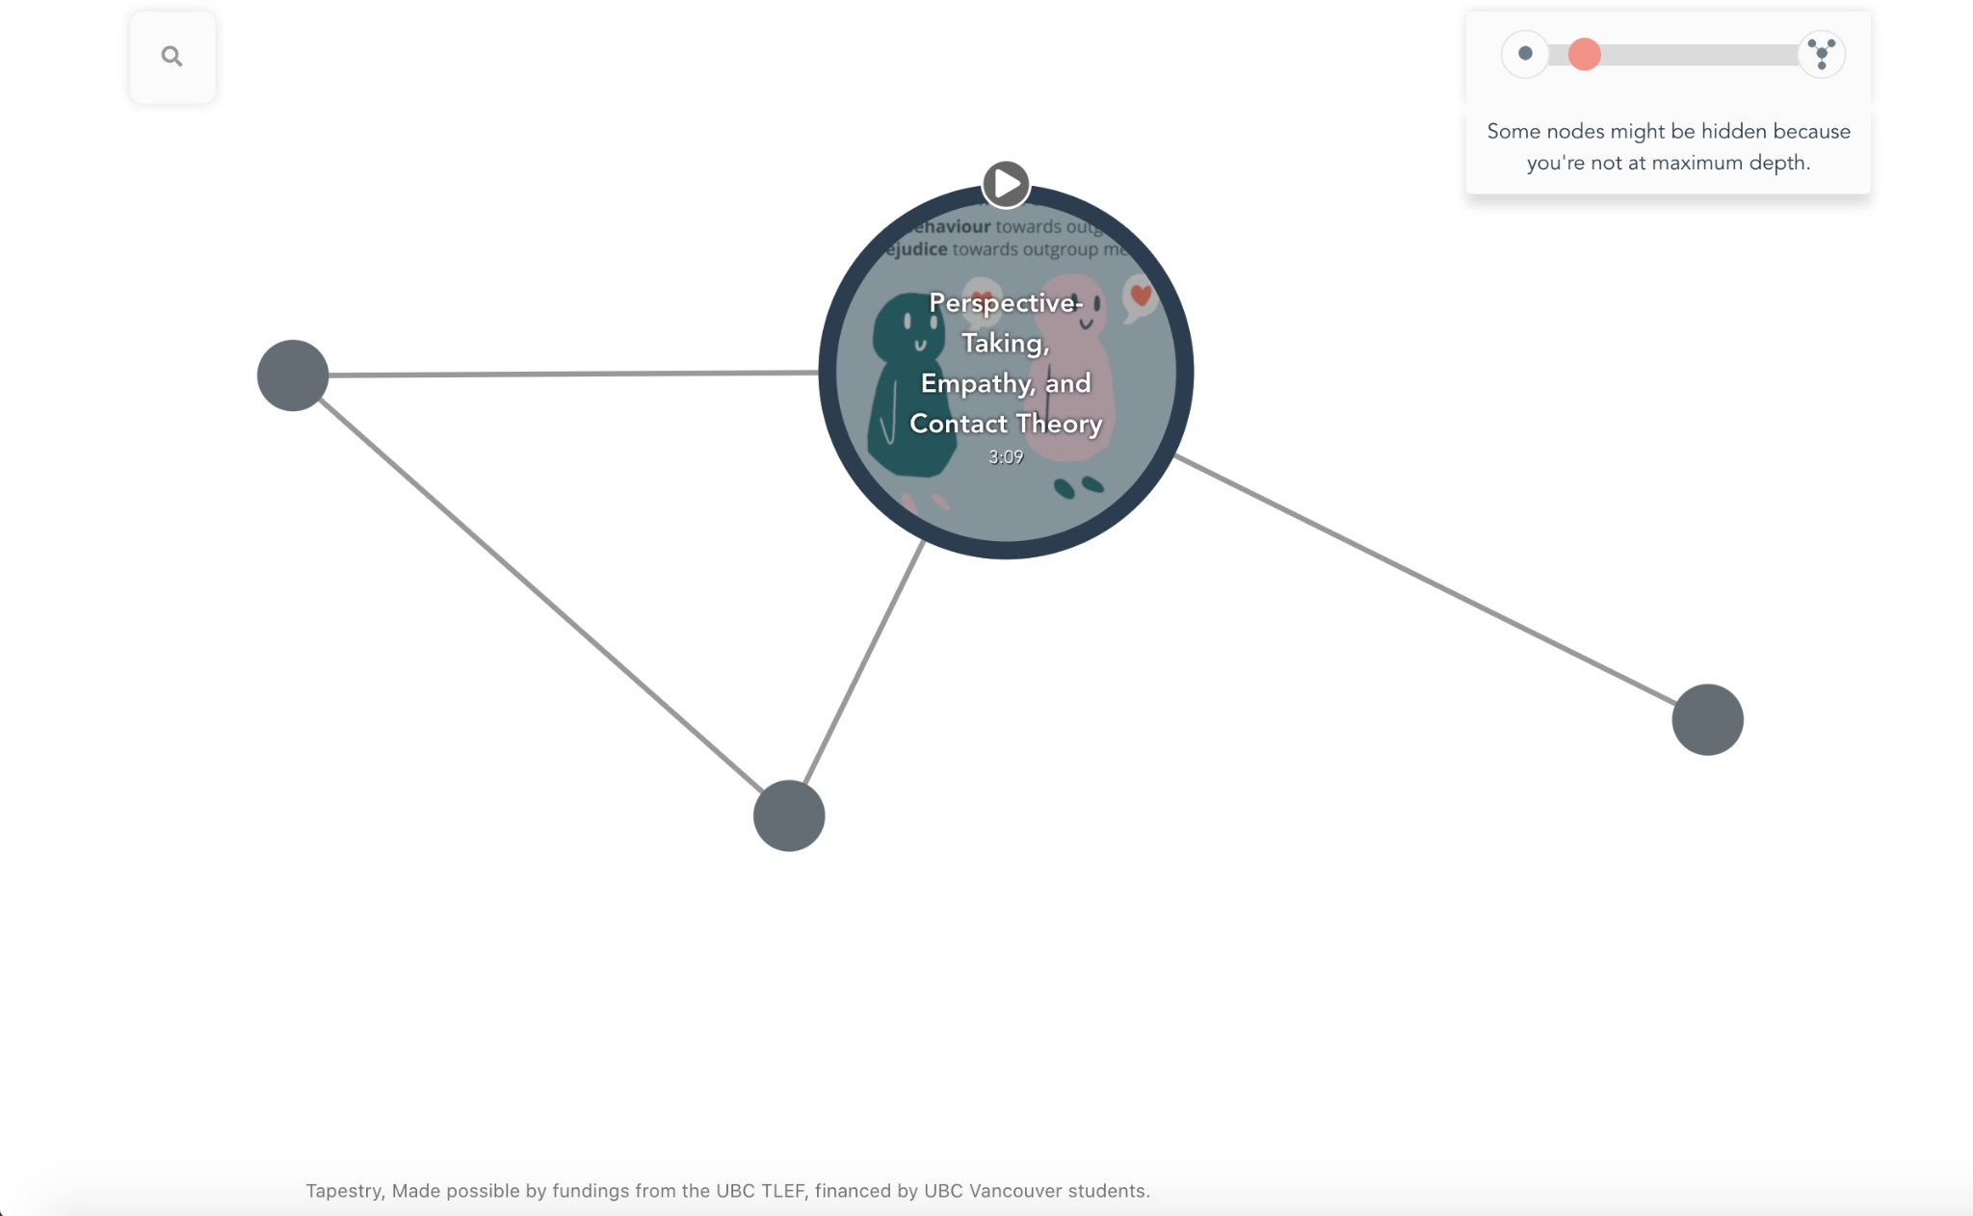
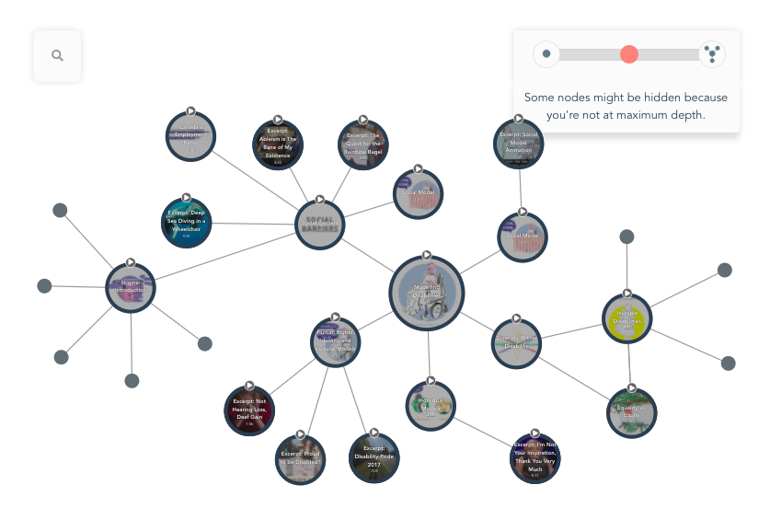
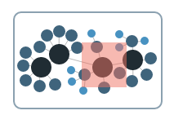
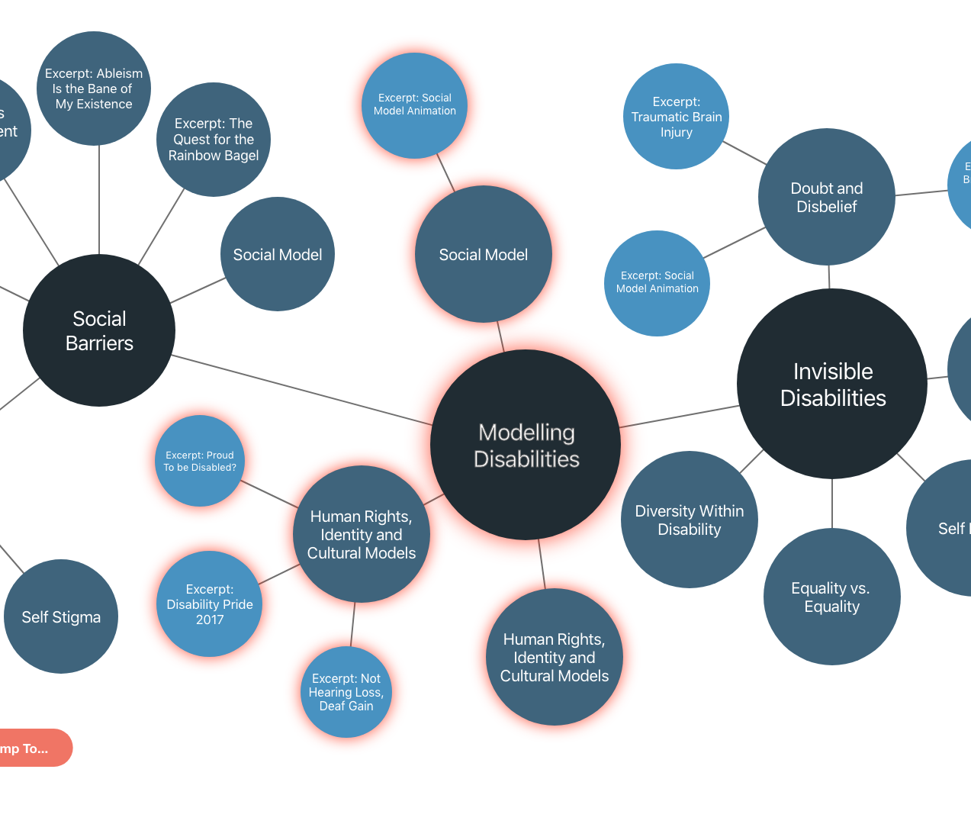
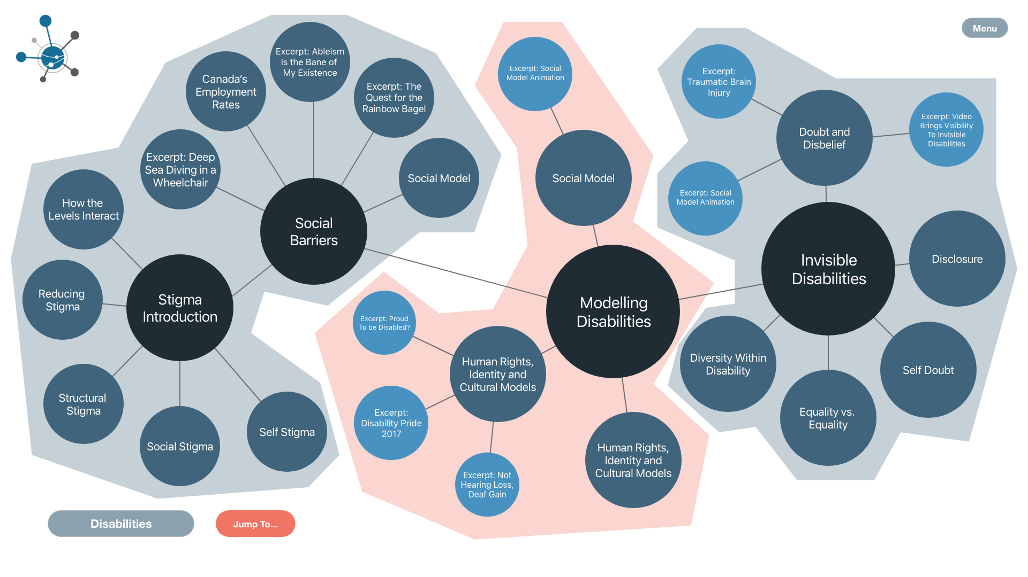
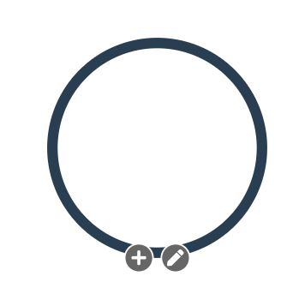
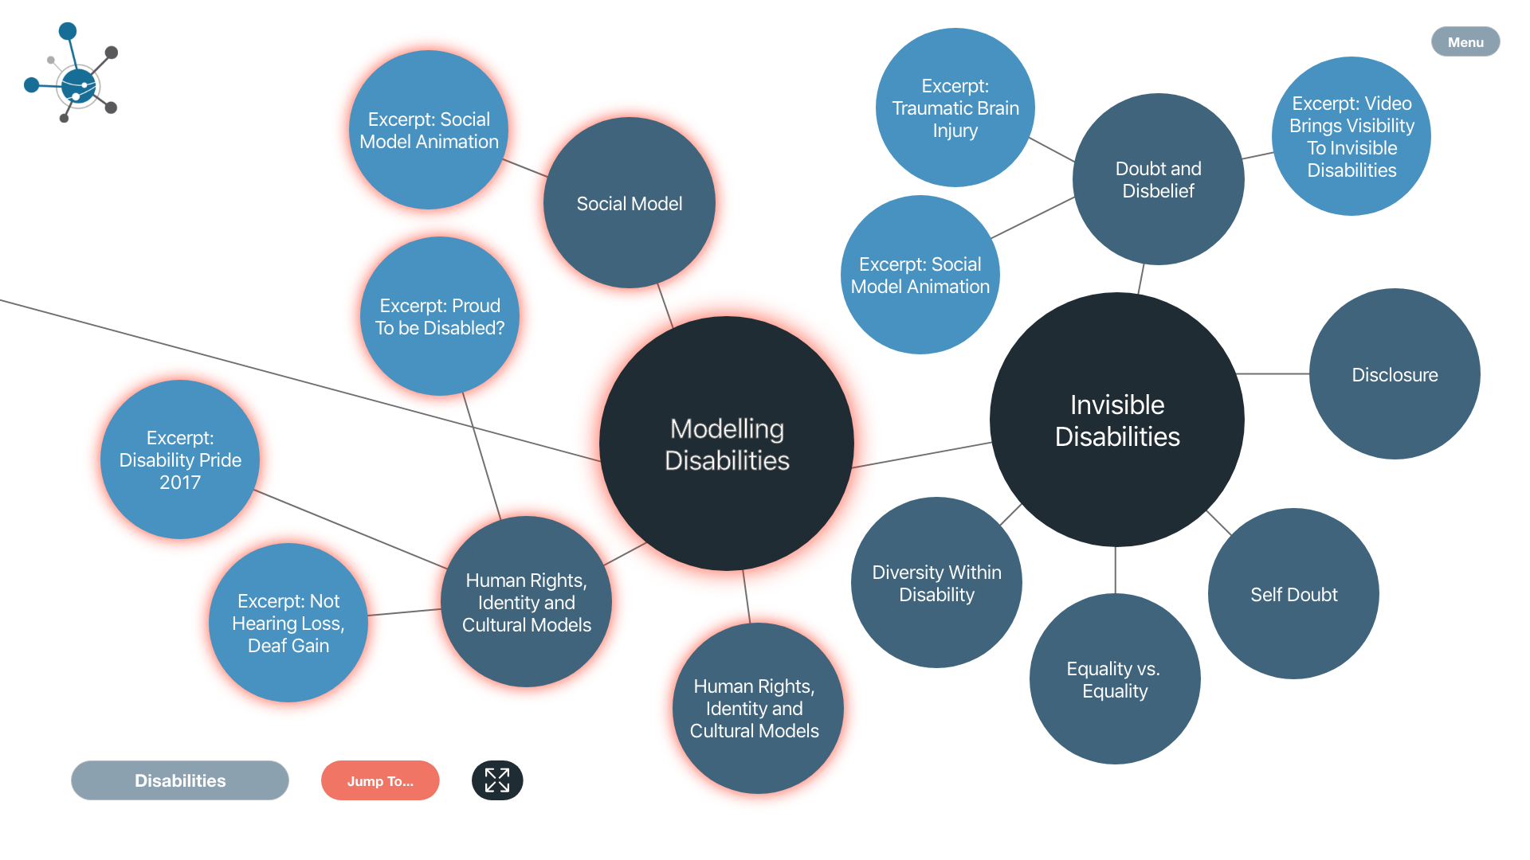
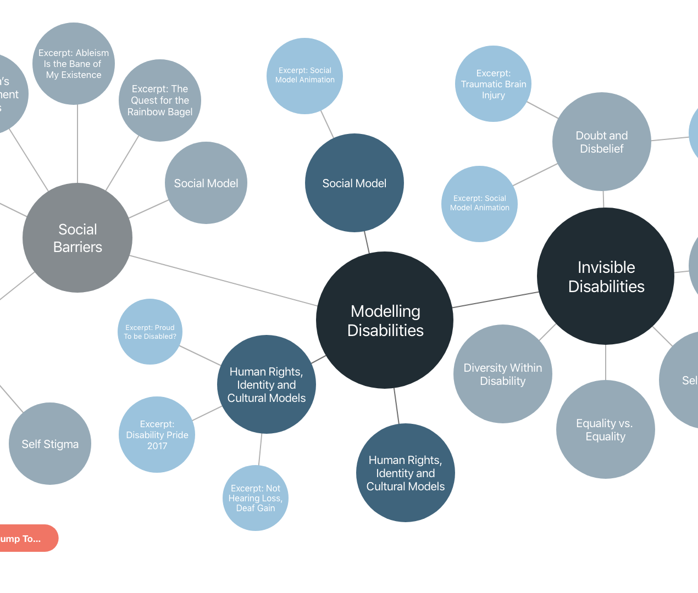
1) EMPATHIZE
2) DEFINE
4) PROTOTYPE & TEST
3) IDEATE
5) EVALUATE
Improving Navigation in Large Tapestries:
User Evaluation of the Tapestry 2.0 Interface
By: Melanie Butt, Bita Jokar, Steven J. Barnes
2
?
Disabilities Module Task
- Evoking “Large Tapestries Problem”
- Navigating nodes
- Node-related questions
- Short-answer questions
1
4
Content → Nodes → Tapestry
See connections
and overview of content
Comparing Mockups
- Combinations of visualization and feature types
- Ratings and preference scores
Research Question:
Which specific features and visualizations of the tool will optimize user navigation and understanding of hierarchy in Tapestry?
3
Users had trouble deciding where to click next, but ultimately we decided not to implement directionality.
If overview, then can see all content, but not the titles. If narrow focus, then lose big picture.
Walkthrough Tapestry
- Navigating a tapestry
- Opening nodes
Videos of Interactive Mockups
- Displaying visualization and feature types
- Ratings and preference scores
Content → Nodes → Tapestry
5
Final Short-Answer Questions
- Best solution
- Issues that arose
- Missing features
Mini Map
Halo
Findings
Future Directions
 | Why? | M_{rating} (out of 10) | Pref.choice
Halo | clarity | 5.28 | 11/43
Nbhd | differentiation | 6.74 | 22/43
Grey | aesthetic & clarity | 5.37 | 10/43
Limitations
Method of Data Analysis
Mockups - combination of:
- 3 features
- 3 visualization types
- Quantitative: Mean rating scores, preferences
- Qualitative: Highlighting main themes
Tapestry 3.0:
- Information remains displayed at different levels
- Scale nodes when zooming in, to preserve hierarchy
Will implement mini map
Node sidebar (node information)
Magnifier
Neighbourhood
Order effect with mockups
Neighbourhoods visualization more detailed and complex than others
Loading issues
No control for familiarity with Tapestry
Sample qualitative questions
2. Was there a specific solution to the “Large Tapestry Problem” that you found particularly useful? Explain.
4. Is there another functionality/feature you would have found more useful to help with the "Large Tapestry Problem"? Please describe.
Features (mockups):
-Chose mini map nearly every time
-Indifferent to magnifier
-Prefer no zoom
Disabilities Module
Example
Zoom
Greyed Out
Qualitative:
-Preferred zoom
-Aesthetic appeal, visual clarity, categorization or differentiation, and findability
Acknowledgments: Jade Guo, Simi Wei, Linnea Ritland, Vivian Lam, Stephanie Chen, Aidin Niavarani, UBC Teaching and Learning Enhancement Fund

Slide 2
EMPATHIZE
Content → Nodes → Tapestry
See connections and overview of content
Users had trouble deciding where to click next, but ultimately we decided not to implement directionality.
If overview, then see all content, but not the titles. If narrow focus, then lose big picture.

Slide 3
DEFINE
?
Research Question:
Which specific features and visualizations of the tool will optimize user navigation and understanding of hierarchy in Tapestry?

Slide 4
IDEATE
Mini Map
Halo
Mockups - combination of:
3 features
3 visualization types
Magnifier
Neighbourhood
X.1, X.2
Preference
X.3, X.4
Preference
X.1, X.2, X.3, X.4
Preference
X.5, X.6
Preference
X.7, X.8
Preference
X.5, X.6, X.7, X.8
Preference
Greyed Out
Zoom
X.1, X.2, X.3, X.4,X.5, X.6, X.7, X.8
Preference

Slide 5
PROTOTYPE & TEST
2
Disabilities Module Task
- Evoking “Large Tapestries Problem”
- Navigating nodes
- Node-related questions
- Short-answer questions
4
Comparing Mockups
- Combinations of visualization and feature types
- Ratings and preference scores
1
3
Walkthrough Tapestry
- Navigating a tapestry
- Opening nodes
5
Videos of Interactive Mockups
- Displaying visualization and feature types
- Ratings and preference scores
Final Short-Answer Questions
- Best solution
- Issues that arose
- Missing features

Slide 6
EVALUATE
Mini Map
Findings
Method of Data Analysis
Halo
Neighbourhood
Grey Out
- Quantitative: Mean rating scores, preferences
- Qualitative: Highlighting main themes, categorizing
Disabilities Module
 | Why? | M_{rating}(out of 10) | Pref.choice
Halo | clarity | 5.28 | 11/43
Nbhd | differentiation | 6.74 | 22/43
Grey | aesthetic & clarity | 5.37 | 10/43
Sample qualitative questions
2. Was there a specific solution to the “Large Tapestry Problem” that you found particularly useful? Explain.
4. Is there another functionality/feature you would have found more useful to help with the "Large Tapestry Problem"? Please describe.
5. Do you feel that you fully understood the purpose of this study and the information/feedback we are trying to capture?

Slide 7
EVALUATE
Findings
Features (mockups):
Chose mini map nearly every time
Indifferent to magnifier
Prefer no zoom
Mini Map
Magnifier
Zoom
Qualitative:
Preferred zoom
Aesthetic appeal, visual clarity, categorization or differentiation, and findability
 | Zoom |  |  | No Zoom
 | No Mag | Mag | OUT OF 4 | MM | No MM | OUT OF 4 | OUT OF 8
 | No MM vs MM | No MM vs MM |  | No mag vs Mag | Mag vs No mag
Halo | 1.1 vs 1.2 (19/43 vs 24/43) | 1.3 vs 1.4 (15/43 vs 28/43) | 1.4 (18/43) | 1.5 vs 1.6 (22/43 vs 21/43) | 1.7 vs 1.8 (24/43 vs 19/43) | 1.7 (24/43) | 1.6 (8/43)
Nbhd | 2.1 vs 2.2 (18/43 vs 25/43) | 2.3 vs 2.4 (17/43 vs 26/43) | 2.4 (16/43) | 2.5 vs 2.6 (21/43 vs 22/43) | 2.7 vs 2.8 (22/43 vs 21/43) | 2.6 (13/43) | 2.6 (11/43)
Grey | 3.1 vs 3.2 (17/43 vs 26/43) | 3.3 vs 3.4 (18/43 vs 25/43) | 3.4 (15/43) | 3.5 vs 3.6 (20/43 vs 23/43) | 3.7 vs 3.8 (25/43 vs 18/43) | 3.5 (12/43) | 3.6 & 3.8 (both 8/43)

Slide 8
EVALUATE
Limitations
Order effect with mockups
Neighbourhoods visualization more detailed and complex than others
Loading issues
No control for familiarity with Tapestry
Example

Slide 9
EVALUATE
Future Directions
Tapestry 3.0:
Information remains displayed at different levels
Scale nodes when zooming in, to preserve hierarchy
Will implement mini map
Node sidebar (node information)

Slide 10
Questions?
Thank you
for listening.
Email: tapestry-support@psych.ubc.ca
Website: https://tapestry-tool.com
Acknowledgments: Jade Guo, Simi Wei, Linnea Ritland, Vivian Lam, Stephanie Chen, Aidin Niavarani, UBC Teaching and Learning Enhancement Fund

